Slide 1










Joyful Analytics present
The Happiness Project
Sunil Malhi
Tafadzwa Fararira
Yuk Hang Hui
Nida Ballinger-Chaudhary
Notes:
Sunil - Title/team name/group members
Good evening everyone. Today, I have the pleasure of introducing our team the Joyful Analytics and our final project: The Happiness Project – a project that sits at the intersection of data science and well-being.
As we navigate the complexities of modern life, the pursuit of happiness remains at the core of our endeavours. But happiness often feels like an enigma – a subjective experience influenced by myriad factors that vary from person to person. That's where our project steps in.

Slide 2
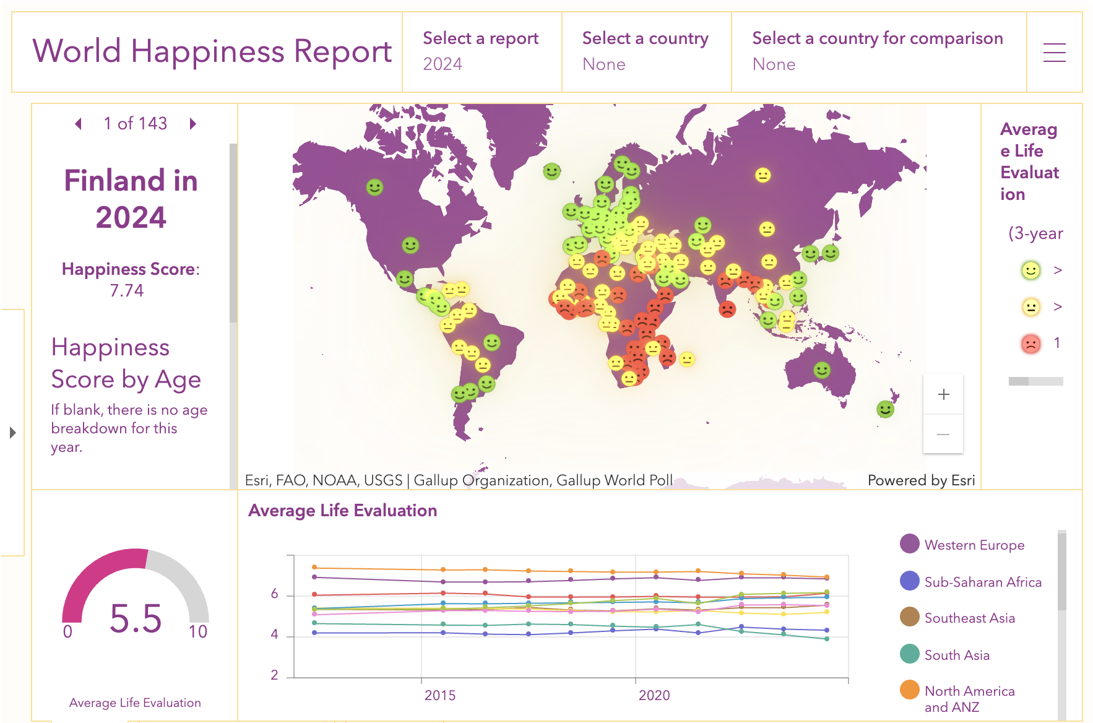
Unlocking Happiness
Understanding What Influences Our Well-being
Utilizing global data to predict individual happiness.
Insight into factors that contribute to well-being.
Enhancing awareness and personal growth.
Notes:
Sunil – Motivation
We've taken a data-driven approach to unravel the elements that play pivotal roles in shaping our sense of happiness. By analysing the World Happiness Report's extensive dataset, we aim to build a model that doesn't just predict overall happiness levels but also provides a deeper understanding of how different factors contribute to our well-being. From economic prosperity and social support to personal freedoms and health – our model considers it all.
While we have only been able to classify a dichotomy our ultimate goal is to be able to offer individuals personalized insights that can aid in self-awareness and personal growth. Imagine being able to pinpoint the areas of your life that, if improved, could significantly boost your happiness. That's the empowering potential of this project. But this is more than just an academic exercise. By shedding light on the quantitative aspects of happiness, we also hope to spark conversations and actions that lead to positive change at both individual and societal levels. So, let's dive in and explore the fascinating insights our data reveals because understanding happiness is the first step toward creating more of it.

Slide 3

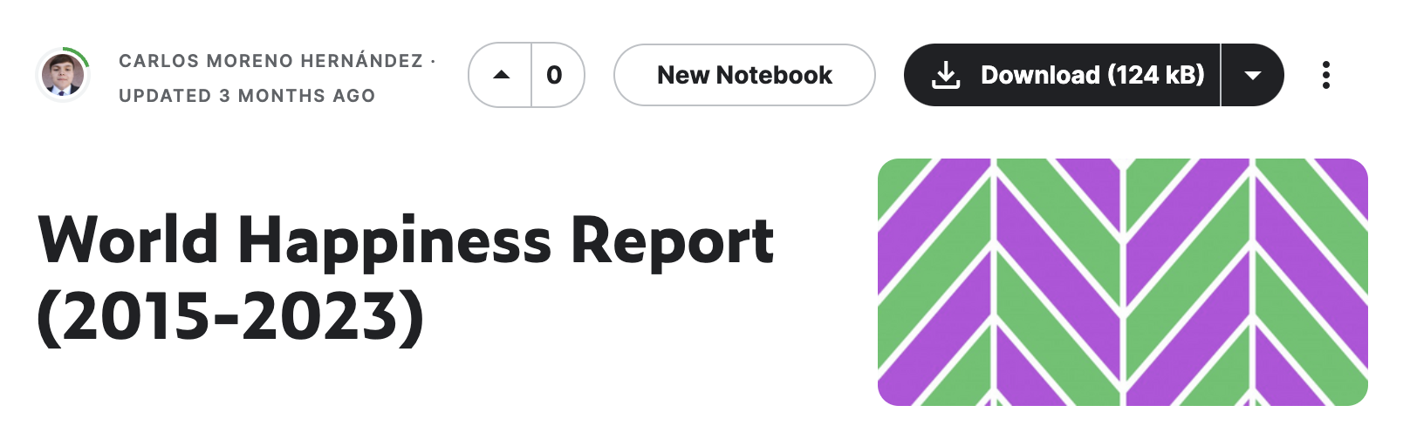
Exploring the Data Landscape
Dataset and Key Variables
GDP per Capita
Reflecting the economic health and individual prosperity.
Social Support
Measuring the presence of support networks.
Healthy Life Expectancy
Gauging the average health and wellness span.
Freedom to Make Life Choices
Assessing the personal autonomy in life decisions.
Generosity
Capturing the average propensity to help others.
Perceptions of Corruption
Understanding trust in institutions.
Dystopia Residual
Representing the unexplained contentment with life.
Social Support
Healthy Life Expectancy
Freedom to Make Life Choices
Generosity
Perceptions of Corruption
Dystopia Residual
Notes:
Sunil – Dataset and Variables
We used a dataset from Kaggle that had compiled the World Happiness Report, an annual publication of the United Nations Sustainable Development Solutions Network from its inception in 2015 to 2023. This dataset provides a comprehensive snapshot of the state of global happiness, compiled from responses of thousands of individuals across various countries.
The key variables we focus on include GDP per Capita, Social Support, Healthy Life Expectancy, Freedom to Make Life Choices, Generosity, Perceptions of Corruption and Dystopia Residual.
I now handover to Nida, to tell you about the ETL and EDA.

Slide 4
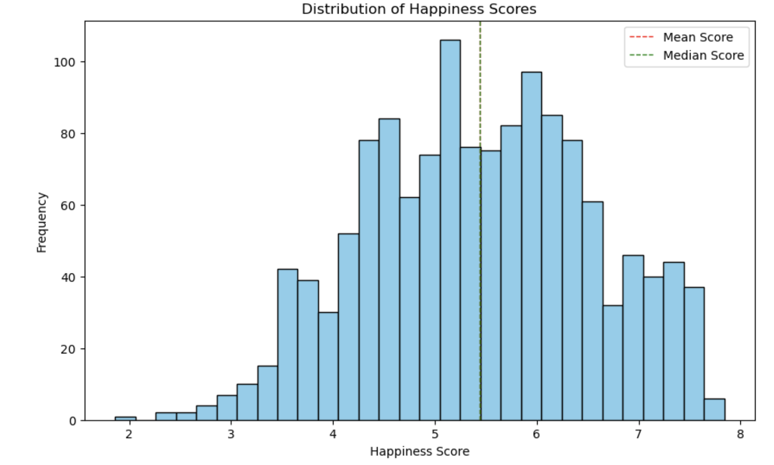
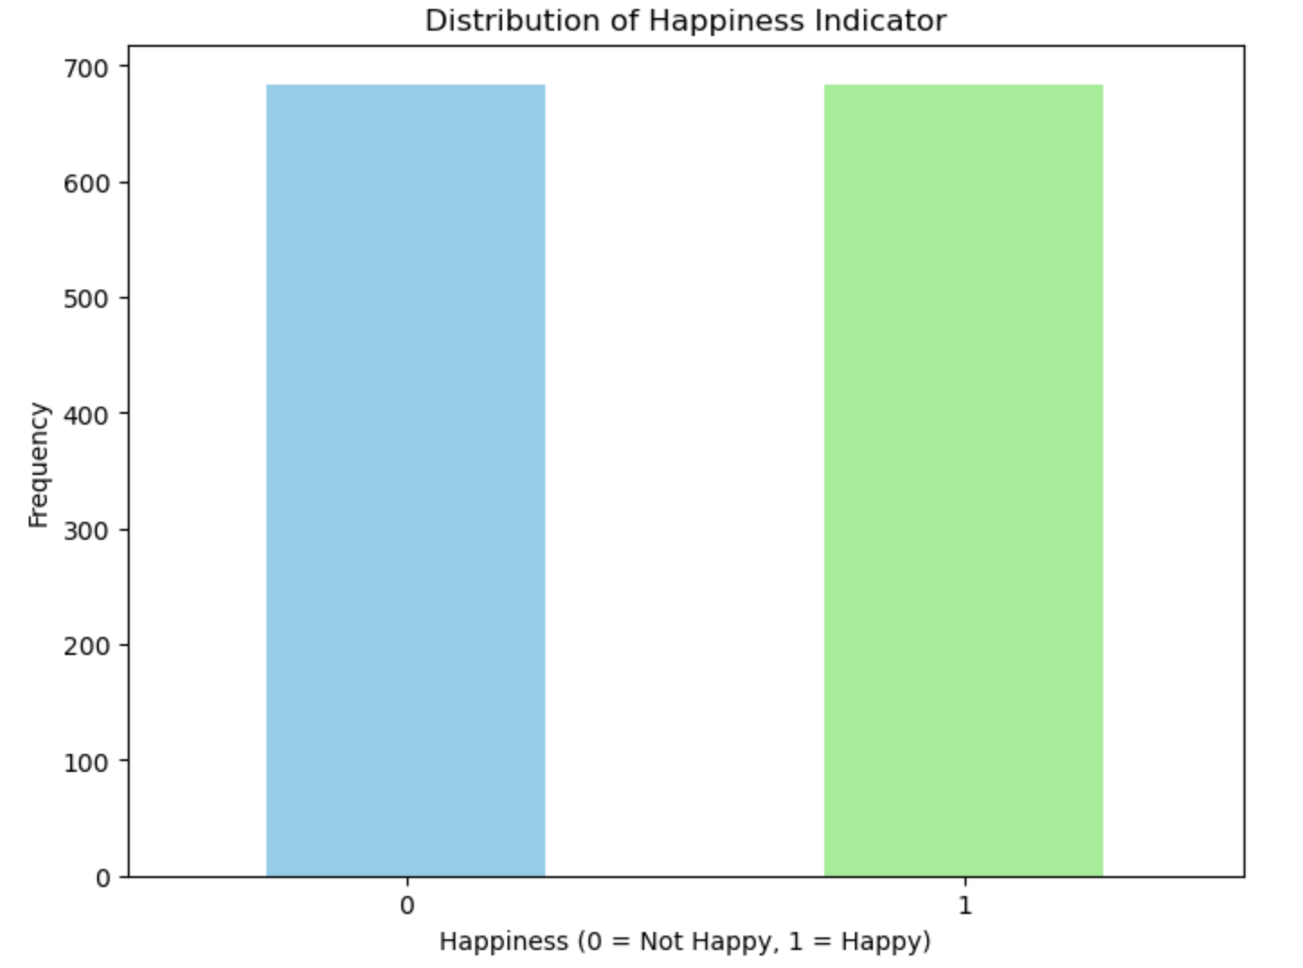
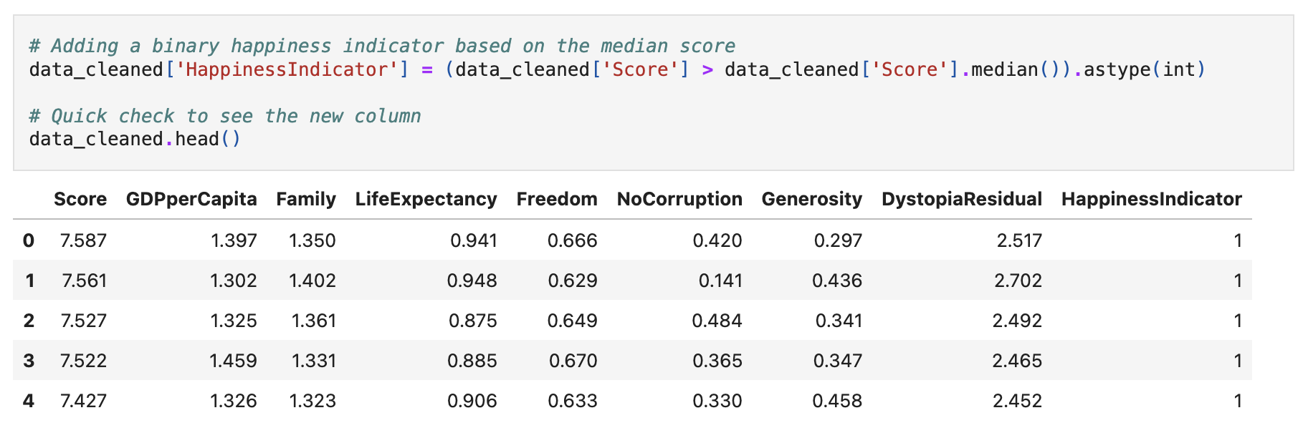
ETL Process Overview
Extract, Transform and Load
Data Extraction
Data Extraction
Utilizing the World Happiness Report
Data Transformation
Cleaning and Anonymization
Feature Engineering a binary “Happiness Indicator”
Prepared for Model Building
Loaded to an SQLite Database for app deployment
Data Transformation
Data Loading
Notes:
Nida – ETL
Our team has meticulously cleaned and processed the data to ensure the highest level of accuracy and reliability for our model.
We started with the extraction form Kaggle of our raw dataset of 1367 unique records spanning 9 years from the the World Happiness Report.
Next is the transformation stage. Here, we cleaned the data, stripping away identifiers to ensure anonymity. We removed irrelevant columns such as country names, rankings, and identifiers that might bias our predictions. What we're left with is the essence of the data – the pure metrics that quantify happiness.
We also visualised the distribution of happiness scores. A histogram lays bare the collective emotional landscape, with the average happiness score marked prominently, guiding our cutoff point for binary classification our “Happiness Indicator”
Finally, we load this cleansed dataset, carving a clear path towards our objective of building a predictive model. This ETL process is not just about preparing data; it's about setting the stage for insight, for discovery, and for a deeper understanding of happiness.
Now, let's delve into the Exploratory Data Analysis that gives us the first glimpse of the stories our data tells.

Slide 5
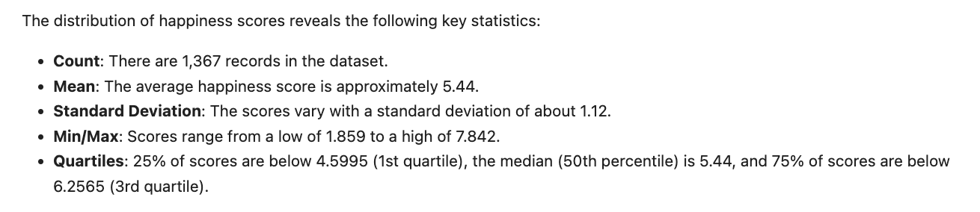
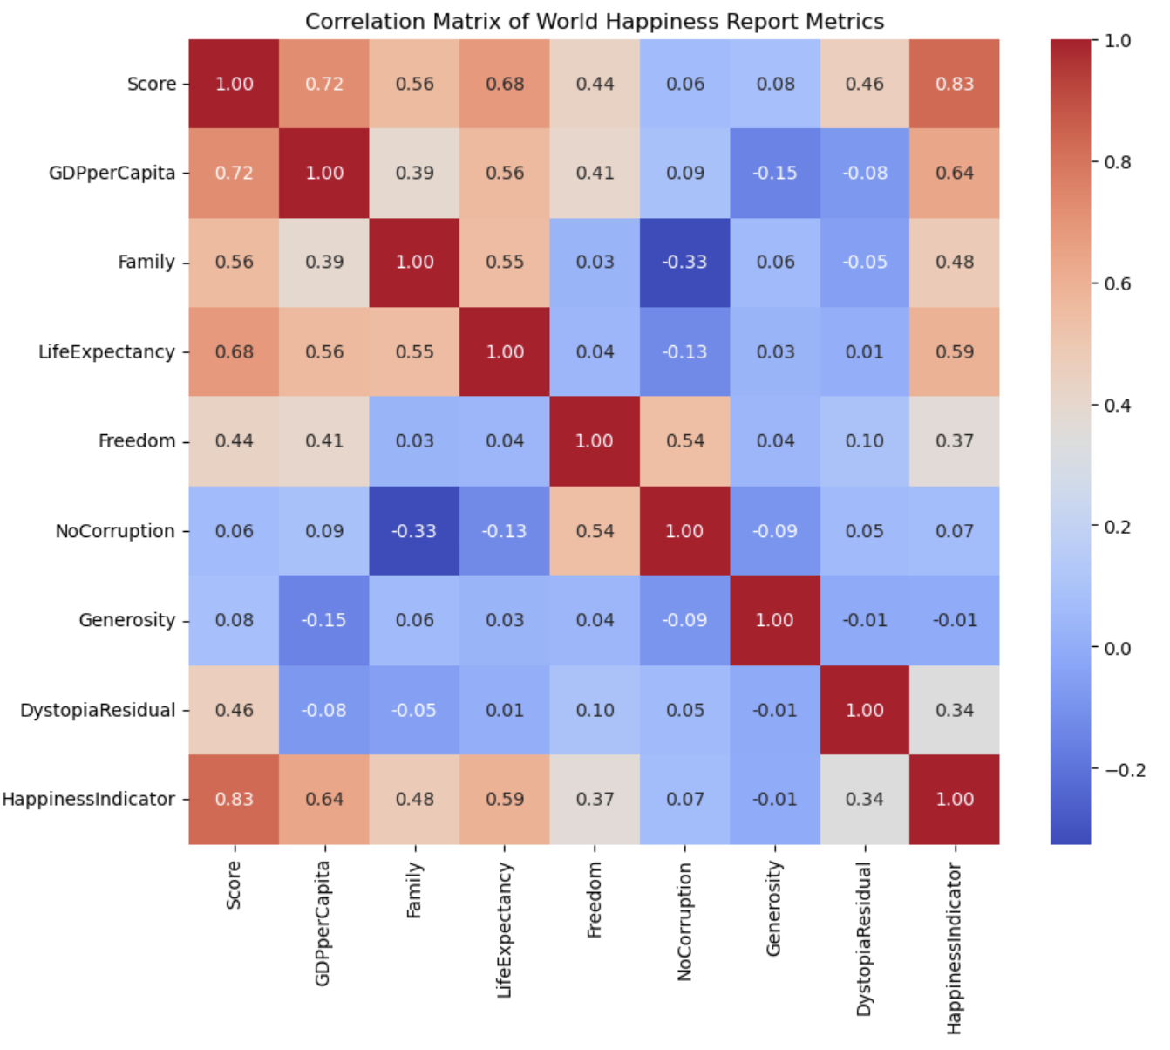
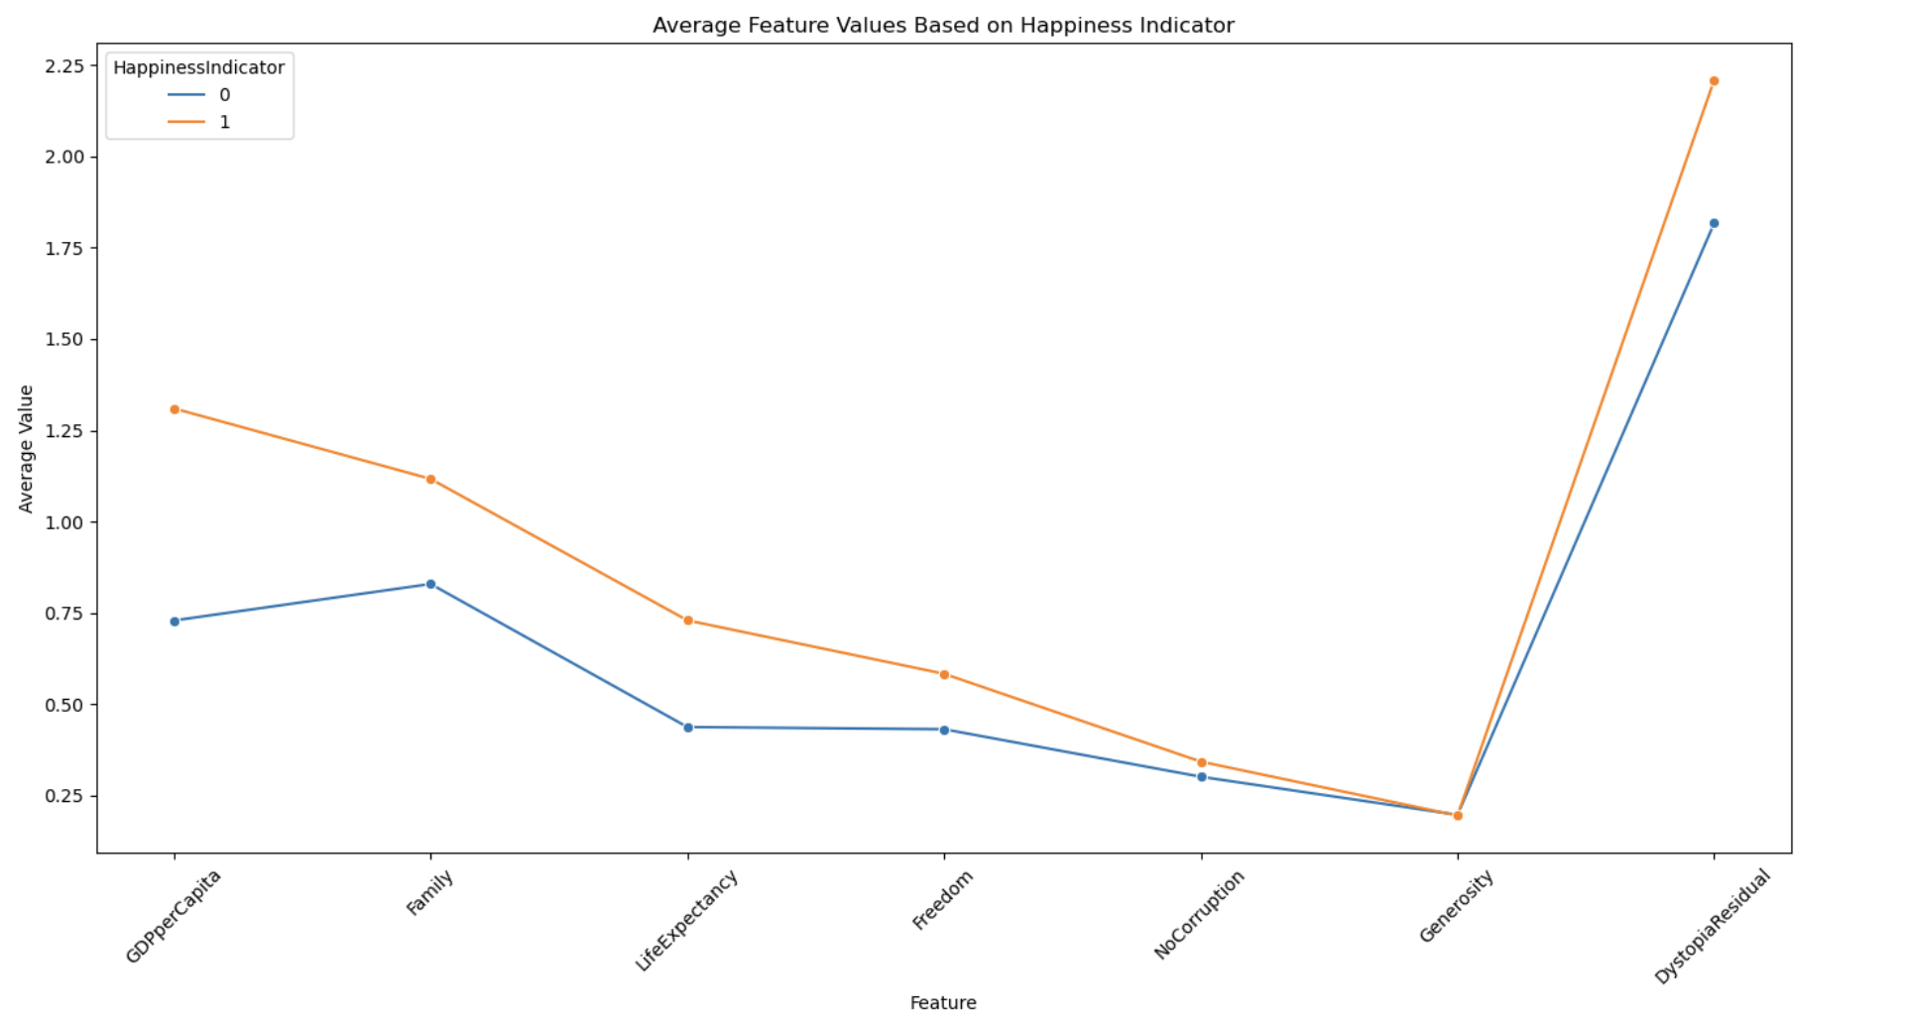
Exploratory Data Analysis
Key Insights
Notes:
Nida – EDA
A statistical summary offers us a bird's-eye view—revealing the mean happiness score hovering around 5.44, with a standard deviation suggesting varied levels of happiness across the globe.
The line chart illustrates a comparison between the average values of various factors contributing to happiness for individuals classified as happy (1) and not happy (0), with a notable divergence in perceptions of corruption, generosity, and dystopia residual.
The correlation matrix goes deeper, displaying the interrelationships among these factors. We observe the powerful link between economic prosperity and life expectancy with happiness, the moderate influence of freedom, and the subtle touch of generosity.
This EDA is our map through the terrain of human emotion and satisfaction, charting a course towards predicting happiness.

Slide 6
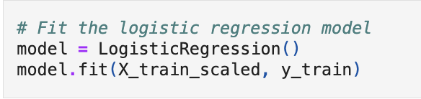
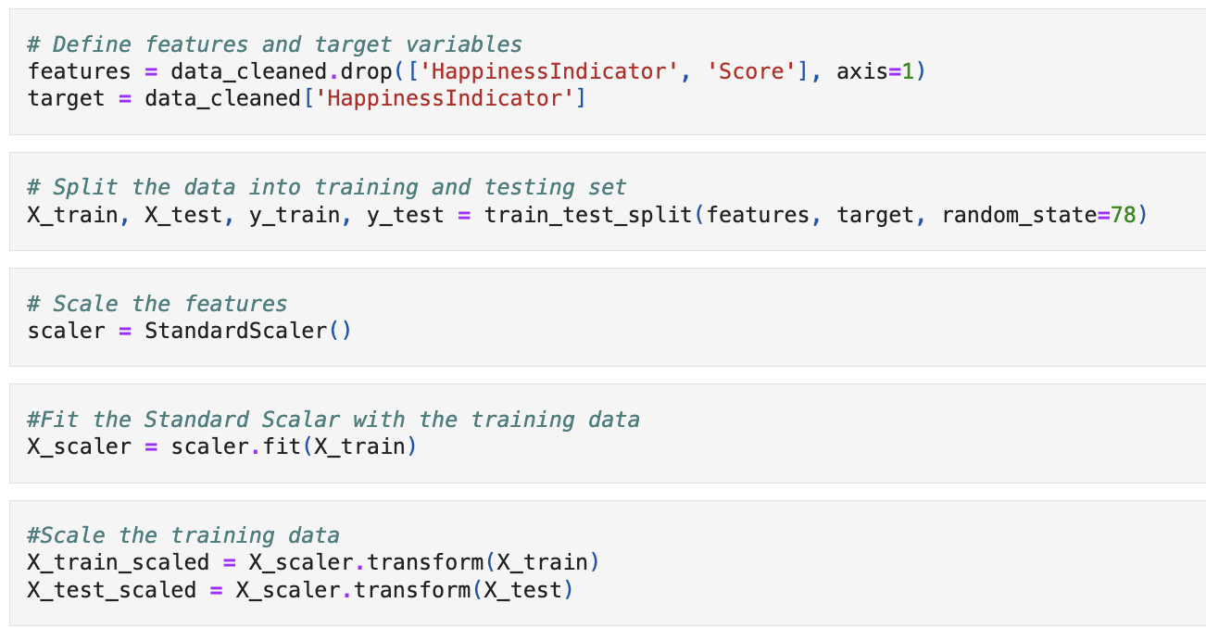
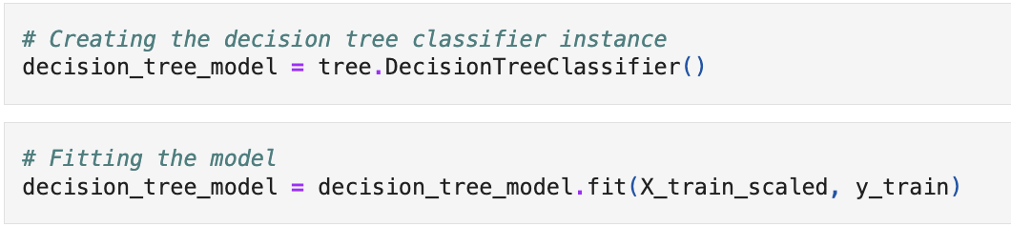
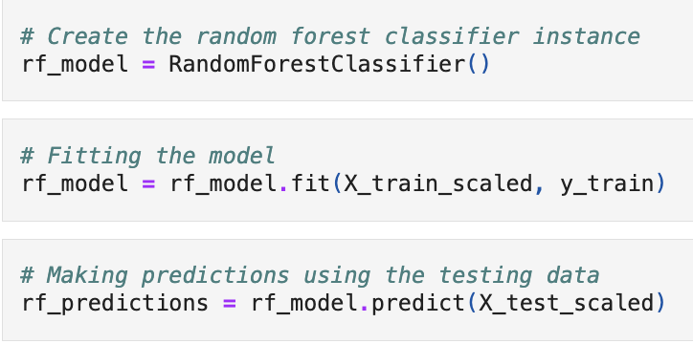
Model Development
Logistic Regression Model
Supervised Learning Models
Decision Tree Model
Random Forest Model
Notes:
Nida – Model Development
This segment of code is crucial for setting up our predictive models. It starts by selecting the factors that could influence happiness and separates them from our target outcome: the Happiness Indicator. Then, it divides our data into a set for training our models and another for testing their predictions. Finally, it standardizes our features to create a level playing field, so that all the different aspects of happiness are given equal weight in our analysis.
We utilize three distinct machine learning models: Logistic Regression, Decision Tree and Random Forest.
Logistic Regression helps us understand the relationship between our features and happiness on a linear scale.
The Decision Tree model provides an intuitive, graphical representation of the decision-making process of classification.
Lastly, the Random Forest model, an ensemble of Decision Trees, offers a more nuanced view by capturing complex interactions
I now handover to Alex to talk about the performance of the models and which one we chose.

Slide 7
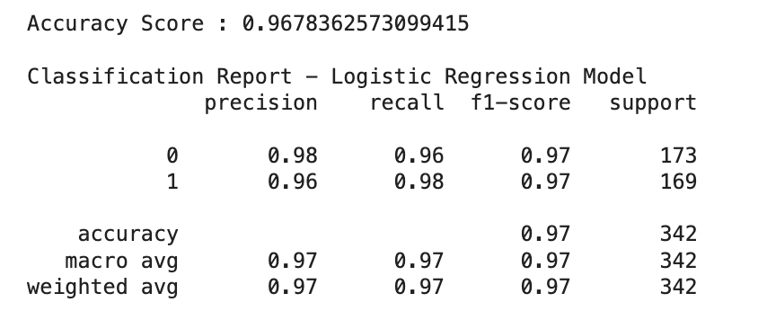
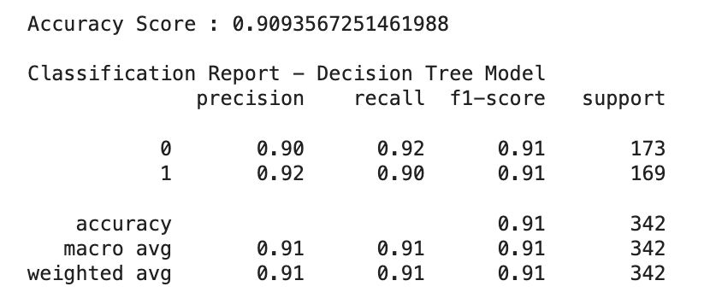
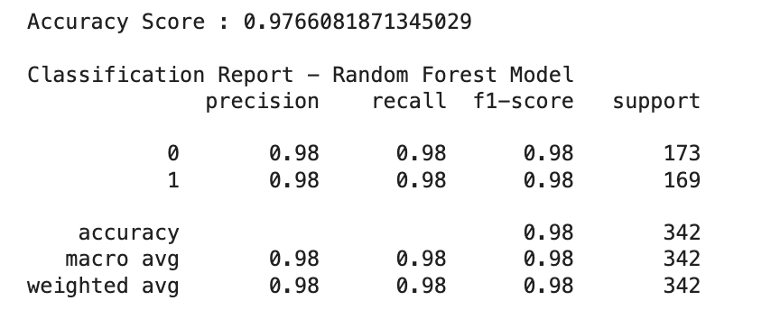
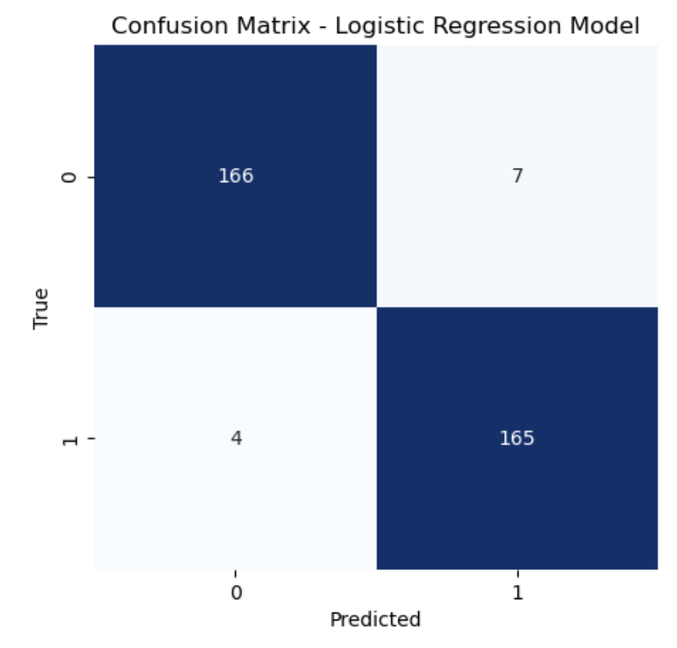
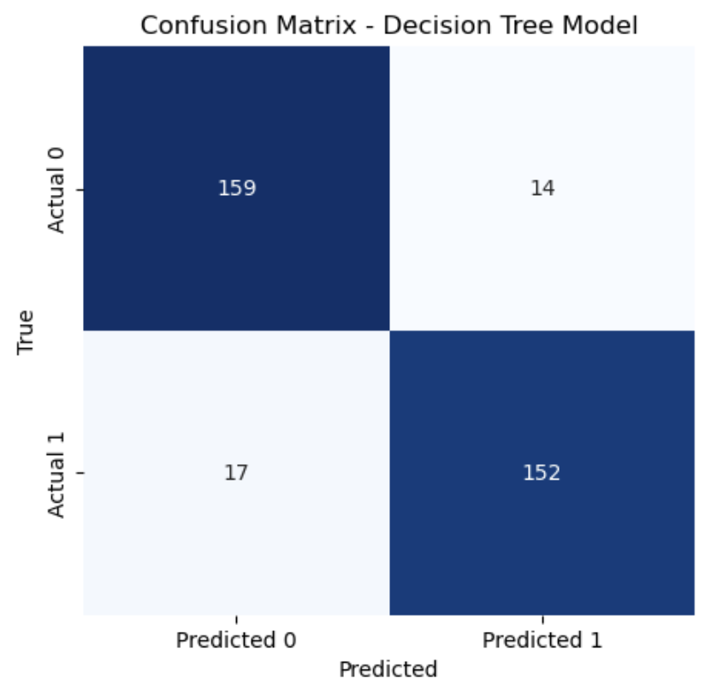
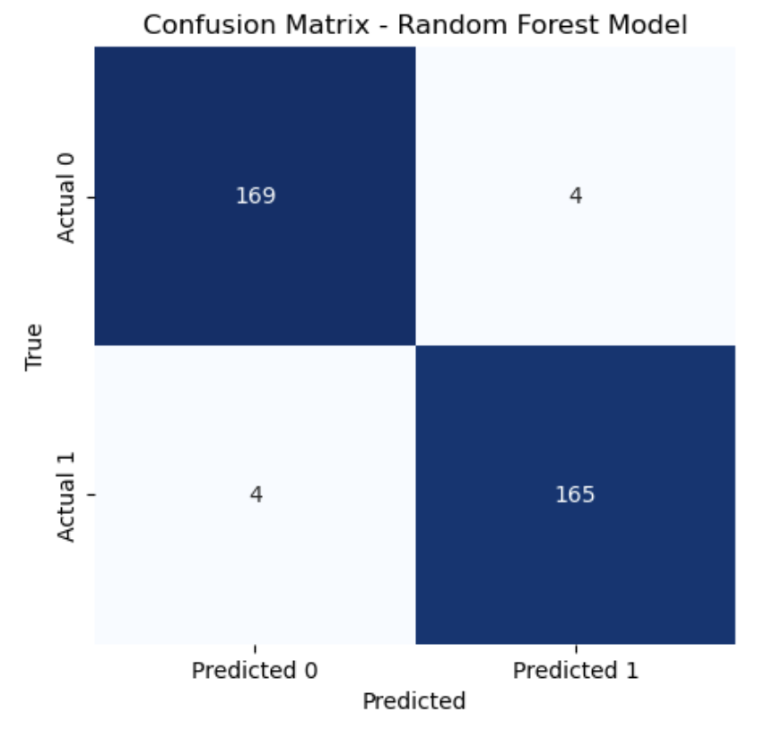
Model Performance
A Comparative Analysis
Logistic Regression Model
Decision Tree Model
Random Forest Model
Notes:
Yuk – Performance Comparison
The slide presents a head-to-head comparison of the three models' performances. The Logistic Regression model showed high accuracy and balanced classification abilities, scoring just above 96% accuracy. It was particularly strong in correctly identifying those not happy, with 166 true negatives and 165 true positives.
The Decision Tree model, on the other hand, displayed an accuracy close to 90%. It showed some imbalance with a slightly higher number of false positives and false negatives, indicating a bit more confusion in classification compared to the Logistic Regression model.
Finally, the Random Forest model, a compilation of decision trees, delivered an impressive accuracy score, just shy of 97%. It maintained a strong balance between classifying happy and not happy instances, with a high number of true positives and true negatives, and very few instances incorrectly classified.

Slide 8
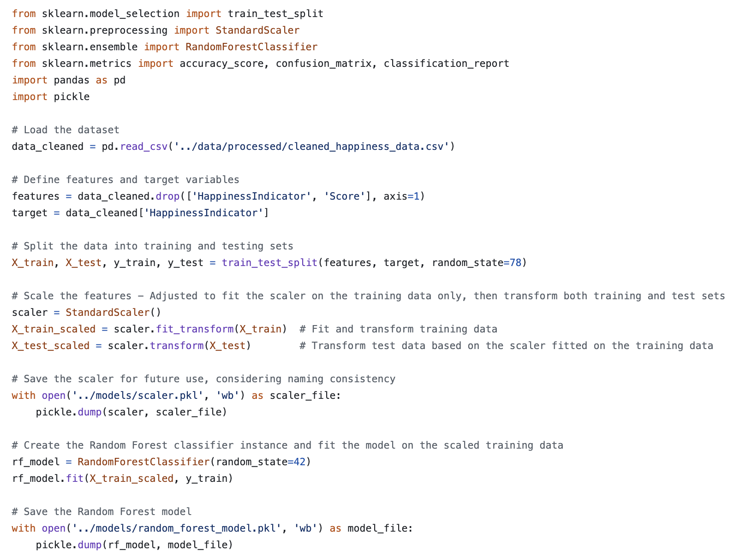
Final Model Selection
Rationale for choosing the Random Forest Model
Accuracy and Performance
It showcases commendable accuracy, adeptly balancing precision and recall, which renders it the most reliable option for predicting happiness compared to the other models.
Handling Complex Relationships
Its ensemble approach empowers the model to adeptly navigate the complex interplay of features influencing happiness, a capability that is vital for accurate predictions.
Robustness and Generalizability
Demonstrating robustness and the capacity to generalize, the Random Forest model mitigates overfitting risks and stands out for its reliable performance across diverse datasets.
Interpretability and Feature Importance
Despite the Decision Tree model's edge in interpretability, the Random Forest model offers substantial insights into feature relevance, providing a clear path for application refinement and a deeper understanding of happiness determinants.
Notes:
Yuk – Rationale behind choosing Random Forest Model
In the rigorous quest for the most effective model for our Happiness Predictor application, the Random Forest algorithm has been selected for its standout performance and robustness. This advanced model shines in its ability to process complex relationships within the data, providing nuanced and highly accurate predictions about happiness.
What differentiates the Random Forest is its resilience against overfitting—its structure, which is akin to a council of decision-making trees, ensures that it does not just memorize the training data but truly understands the underlying patterns.
To seamlessly integrate this powerful model into our application, we've employed serialization techniques, storing the model and its corresponding StandardScaler as serialized objects. This crucial step encapsulates the predictive power of our model, preserving its intricate calibrations, ready to be deployed in the app environment with precision and reliability.
I now hand over to Taz to tell you about our Happiness Predictor Application that we built using this Random Forest Algorithm.

Slide 9
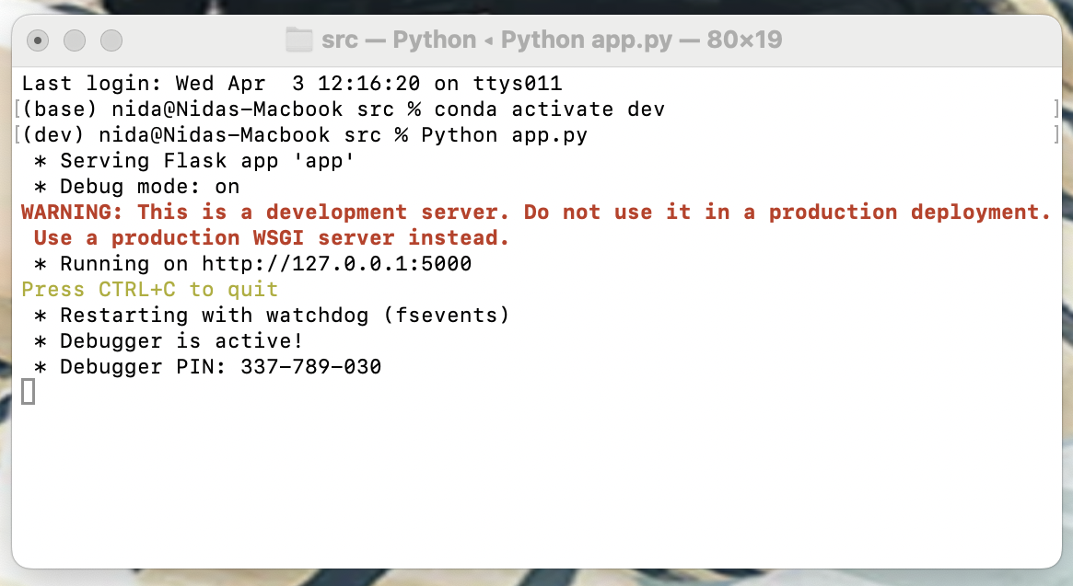
Happiness Predictor App
Web Application Overview
Model and Scaler Loading
The application initializes by loading a pre-trained Random Forest model and a scaler to ensure input data matches the expected format for predictions.
Data Loading and Database Integration
A script loads the processed data into an SQLite database via SQLAlchemy, facilitating sophisticated data handling and retrieval for the application.
Prediction Endpoint
A web form endpoint collects user ratings on key life aspects, and processes them through a scaler and the Random Forest model to predict happiness levels.
Result Visualisation
The application employs Plotly to craft interactive graphs that position the user's happiness metrics in the context of worldwide data.
Notes:
Taz – Showcase app.py code/deployment
The app.py script is the backbone of a Flask web application designed to predict happiness scores based on the World Happiness Report data. It utilizes a machine learning model to forecast an individual's happiness category ('Happy' or 'Not Happy') using various indicators of well-being and national prosperity.
Before I showcase it to you, let me talk you through the key features:
At its core, the app bootstraps with a pre-trained Random Forest model and scaler, ensuring we're primed for precise predictions right from the start.
Integration with an SQLite database via SQLAlchemy elevates our data management, making our insights deeper and predictions sharper. Users engage through a simple form, rating aspects of their lives, which we then scale and process to predict their happiness level.
Post-prediction, we leverage Plotly for dynamic visualizations, offering users a visual benchmark of their happiness against global data. With robust input validation, the app ensures clarity and accuracy in user submissions.
Let’s take it for a test run – but first for the most important question on this boot camp – Any volunteers?

Slide 10

Will our model classify you as ‘Happy’ or ‘Not Happy’?
Find Out For Yourself

